Slide 1
Algorithms on Graphs
Gilles Falquet
Université de Genève/GSEM MSc. Business Analytics

Slide 2
Motivations
Some definitions
Data structures for graphs
Accessibility and finding connected components
Path finding problem

Slide 3
Motivations
Many real-world problems can be modeled as graph problems
finding a route (in a road or train system network)
finding the critical tasks in a project
analyzing a social network (finding communities)
building an optimal network
establishing a schedule (for courses, exams, ...)

Slide 4
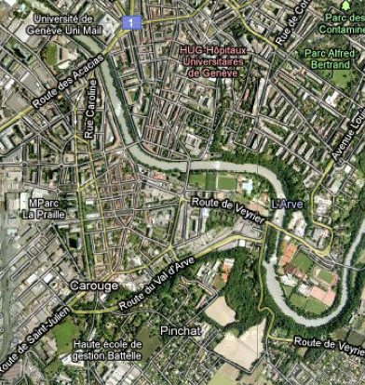
Example: finding the best route
B
A

Slide 5
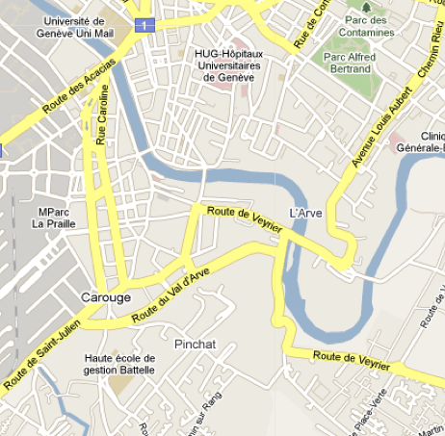
formalization for human processing
B
A

Slide 6
formalization for machine processing
0.23
0.17
0.33
0.27
0.29
0.22
0.22
0.22
1.95
0.37
0.42
0.22
0.46
0.12

Slide 7
Definitions
A graph G is made of two sets
a set V of nodes (or vertices)
a set E is of edges
an edge is a pair {u, v} of nodes
Example
V = {a, b, c, d}
E = {{a, b}, {a, c}, {b, c}, {c, d}}

Slide 8
Adjacency
v₁
If there is an edge e = {v₁, v₂} in G
v₁ and v₂ are called the endpoints of e
v₁ and v₂ are adjacent
The edges induce an adjacency relation
e
v₂

Slide 9
Definitions
A directed graph G is made of
a set V of nodes (or vertices)
a set E is of directed edges (or arcs)
a directed edge is an ordered pair (u, v) of nodes
D = (V, A)
V = {a, b, c, d}
A = {(a, b), (a, c), (c, b), (d, c)}

Slide 10
Data structures for graphs
Must be sufficient to represent the nodes and edges
Must be support an efficient implementation of the adjacency operation
get the nodes that are adjacent to x
test if x is adjacent to y

Slide 11
Simple Adjacency Set Representation
case class Node(name: String){
var adj = Set[Node]() // inner field/attribute
}
val na = Node("a"); val nb = Node("b")
val nc = Node("c"); val nd = Node("d")
na.adj = Set(nb)
nb.adj = Set(na, nc, nd)
nc.adj = Set(nb, nd)
nd.adj = Set(nb, nc)
val g = Set(na, nb, nc, nd)
a
b
d
c

Slide 12
Representing a directed graph
case class Node(name: String){
var out = Set[Node]()
var in = Set[Node]()
}
val na = Node("a"); val nb = Node("b")
val nc = Node("c"); val nd = Node("d")
na.out = Set(nb, nc)
nb.in = Set(na, nc)
nc.out = Set(nb); nc.in = Set(na, nd)
nd.out = Set(nc)

Slide 13
Connectedness
g
a
b
A graph is connected if
for each pair a, b of vertices
there is a path (a sequence of edges)
{a, v₁}, {v₁, v₂}, …, {v_{n-1}, v_{n}}, {v_{n}, b}
that connects a and b
d
c
d
f
e

Slide 14
Connectedness
A connected component of a graph G = (V, E) is
a subgraph G' = (V’, E’) of G such that
G' is connected
there is no other connected subgraph G'' of G such that G' is a proper subgraph of G'' (i.e. G' is maximal)

Slide 15
a graph with 3 connected components

Slide 16
Connectivity problem
How to test if a graph is connected ?
How to find the connected components ?

Slide 17
Depth-first exploration
Principle:
pick a starting node n
explore the graph from n
if all the nodes have been explored the graph is connected
To explore from n :
for each node k adjacent to n
if k has not yet been explored
recursively explore the graph from k
n

Slide 18
Depth-first exploration algorithm
Use a set to memorize the explored nodes
def dfexplore(s: Node, D: Set[Node]) : Set[Node]
D’ = D ∪ {s}
for each n adjacent to s
if n ∉ D’ then D’’ = dfexplore(n, D’)
D’ = D' ∪ D’’
return D’
n

Slide 19
in Scala
def dfe(s: Node, discovered: Set[Node]): Set[Node] = {
var dp = discovered + s
for (n <- s.adj) {
if (!(discovered contains n)) dp = dp ++ dfe(n, dp)
}
dp
}

Slide 20
Execution
dfe(2, {})
1
2
3
4
5

Slide 21
Execution
dfe(2, {})
→ dfe(4, {2})
1
2
3
4
5

Slide 22
Execution
dfe(2, {})
→ dfe(4, {2})
→ dfe(3, {2, 4})
1
2
3
4
5

Slide 23
Execution
dfe(2, {})
→ dfe(4, {2})
→ dfe(3, {2, 4})
← {2, 3, 4}
1
2
3
4
5

Slide 24
Execution
dfe(2, {})
→ dfe(4, {2})
→ dfe(3, {2, 4})
← {2, 3, 4}
→ dfe(5, {2, 3, 4})
1
2
3
4
5

Slide 25
Execution
dfe(2, {})
→ dfe(4, {2})
→ dfe(3, {2, 4})
← {2, 3, 4}
→ dfe(5, {2, 3, 4})
← {2, 3, 4, 5}
1
2
3
4
5

Slide 26
Execution
dfe(2, {})
→ dfe(4, {2})
→ dfe(3, {2, 4})
← {2, 3, 4}
→ dfe(5, {2, 3, 4})
← {2, 3, 4, 5}
← {2, 3, 4, 5}
1
2
3
4
5

Slide 27
Execution
dfe(2, {})
→ dfe(4, {2})
→ dfe(3, {2, 4})
← {2, 3, 4}
→ dfe(5, {2, 3, 4})
← {2, 3, 4, 5}
← {2, 3, 4, 5}
→ dfe(1, {2, 3, 4, 5})
1
2
3
4
5

Slide 28
Execution
dfe(2, {})
→ dfe(4, {2})
→ dfe(3, {2, 4})
← {2, 3, 4}
→ dfe(5, {2, 3, 4})
← {2, 3, 4, 5}
← {2, 3, 4, 5}
→ dfe(1, {2, 3, 4, 5})
← {1, 2, 3, 4, 5}
1
2
3
4
5

Slide 29
Execution
dfe(2, {})
→ dfe(4, {2})
→ dfe(3, {2, 4})
← {2, 3, 4}
→ dfe(5, {2, 3, 4})
← {2, 3, 4, 5}
← {2, 3, 4, 5}
→ dfe(1, {2, 3, 4, 5})
← {1, 2, 3, 4, 5}
← {1, 2, 3, 4, 5}
1
2
3
4
5

Slide 30
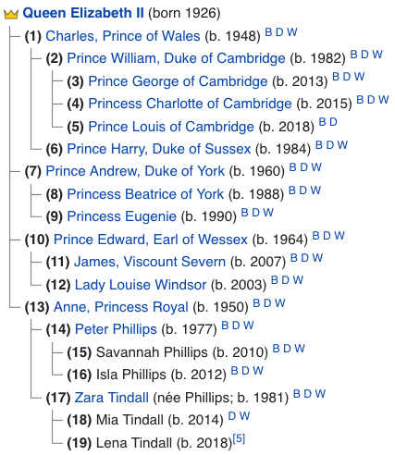
Depth first in practice:
Succession to the British throne

Slide 31
Finding all the connected components
Principle: exhaustively apply the search algorithm
T = the nodes of G
while T is not empty {
select a starting node n in T
let CC = dfe(n)
print CC
T = T – CC
}

Slide 32
in Scala
def printCC = { var t = nodes while (! t.isEmpty) { val from = t.iterator.next() val cc = dfe(from, Set()) println("cc: "+cc) t = t -- cc } }

Slide 33
Path finding
Problem: find a path from s to t in a graph G
Recursive Algorithm:
"A journey of a thousand miles begins with a single step" (Laozi)
=> a path starts with an edge from s to an adjacent node
to find a path from s to t
go to an adjacent node a
find a path from a to t
if not found try with another adjacent node
a
s
a
a
t

Slide 34
In Scala
var explored = Set[Node]()
def findPath(s: Node, t: Node):List[Node] = {
explored = explored + s
if (s == t) return List(s)
for (n <- s.adj) {
if (!(explored contains n)) {
val p = findPath(n, t)
if (p != List()) return s :: p
}
}
List()
}

Slide 35
Embedded in another function
def path(from: Node, dest: Node):List[Node] = {
var explored = Set[Node]()
def findPath(s: Node, t: Node):List[Node] = {
...
}
findPath(from, dest)
}

Slide 36
Execution
path(s, t) ex = {s)
path(a, t) ex = {s, a}
path(d, t) ex = {s, a, d}
← ()
← ()
path(b, t) ex = {s, a, d, b}
path(c, t) ex = {s, a, d, b, c}
path(t, t) ex = {s, a, d, b, c, t}
← (t)
← (c, t)
← (b, c, t)
← (s. b. c. t)
a
d
s
b
c
t
u

Slide 37
Properties of the algorithm
Correctness
by the recursive relation
Non determinism
may yield different results, depending on the order in which the adjacent nodes are considered
Path characteristics
return a simple path (not twice through the same node)
not necessarily the shortest path

