Slide 1
Relational to RDF mapping

Slide 2
Mapping Relational Data to RDF
RDB direct mapping: https://www.w3.org/TR/rdb-direct-mapping/
Customized mapping: https://www.w3.org/TR/r2rml/

Slide 3
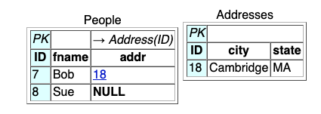
Direct mapping principle
table row ⟼ row graph
row type triple
literal triple for each non NULL column
reference triples for the non NULL foreign key columns
@base <http://foo.example/DB/> .
@prefix xsd: <http://www.w3.org/2001/XMLSchema#> . <People/ID=7> rdf:type <People> .
<People/ID=7> <People#ID> 7 .
<People/ID=7> <People#fname> "Bob" .
<People/ID=7> <People#addr> 18 .
<People/ID=7> <People#ref-addr> <Addresses/ID=18> .
<People/ID=8> rdf:type <People> .
<People/ID=8> <People#ID> 8 .
<People/ID=8> <People#fname> "Sue" .
<Addresses/ID=18> rdf:type <Addresses> .
<Addresses/ID=18> <Addresses#ID> 18 .
<Addresses/ID=18> <Addresses#city> "Cambridge" . <Addresses/ID=18> <Addresses#state> "MA" .

Slide 4
IRI generation
table row with primary key column $K_{1},…K_{m}$ and values $v_{1},…,v_{m}$ → node id IRI
<table-name/$K_{1}=v_{1},…K_{m}v_{m}$>
column name → literal property IRI
<table-name>#<column-name>
foreign key $F_{1},…,F_{n}$ → reference property IRI
<table-name>#$F_{1}$;…;$F_{n}$

Slide 5
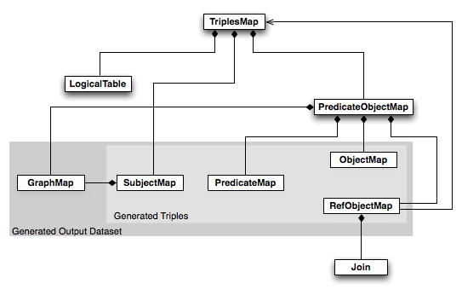
R2RML

Slide 6
EMP
EMPNO INTEGER PRIMARY KEY | ENAME VARCHAR(100) | JOB VARCHAR(20) | DEPTNO INTEGER REFERENCES DEPT (DEPTNO)
7369 | SMITH | CLERK | 10
@prefix rr: <http://www.w3.org/ns/r2rml#>.
@prefix ex: <http://example.com/ns#>.
<#TriplesMap1>
rr:logicalTable [ rr:tableName "EMP" ];
rr:subjectMap [
rr:template "http://data.example.com/employee/{EMPNO}";
rr:class ex:Employee;
];
rr:predicateObjectMap [
rr:predicate ex:name;
rr:objectMap [ rr:column "ENAME" ];
].
<http://data.example.com/employee/7369> rdf:type ex:Employee. <http://data.example.com/employee/7369> ex:name "SMITH".

Slide 7
EMP
EMPNO INTEGER PRIMARY KEY | ENAME VARCHAR(100) | JOB VARCHAR(20) | DEPTNO INTEGER REFERENCES DEPT (DEPTNO)
7369 | SMITH | CLERK | 10
<#TriplesMap1>
rr:predicateObjectMap [
rr:predicate ex:department;
rr:objectMap [
rr:parentTriplesMap <#TriplesMap2>;
rr:joinCondition [
rr:child "DEPTNO";
rr:parent "DEPTNO";
];
];
].
<http://data.example.com/employee/7369> ex:department <http://data.example.com/department/10>.

Slide 8
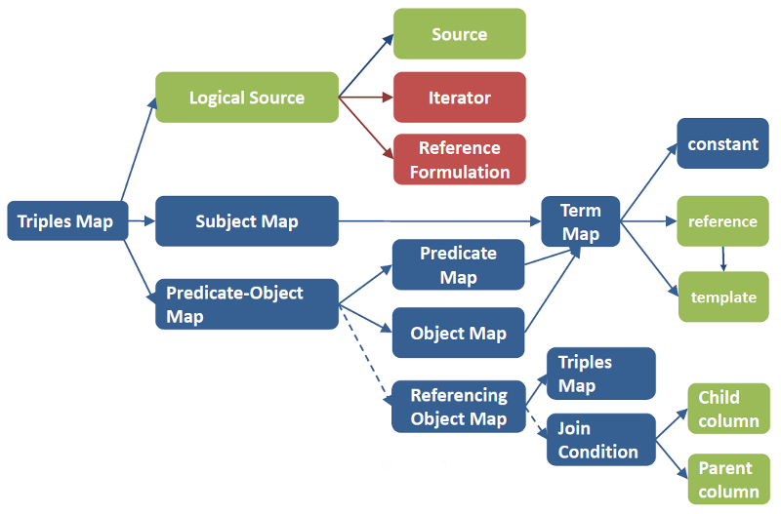
RML
Sources can be anything (relational, JSON, XML, …)

Slide 9
RML Logical Source
<#PersonMapping>
rml:logicalSource [
rml:source "People.json";
rml:referenceFormulation ql:JSONPath;
rml:iterator "$.[*].Person" ].

Slide 10
Subject Map
<#PersonMapping>
rr:subjectMap [
rr:template "http://ex.com/Person/{name}_{surname}";
rr:class ex:Person ].
Predicate object map
<#PersonMapping>
rr:predicateObjectMap [
rr:predicate ex:name;
rr:objectMap [ rml:reference "name" ]
].

